Slide 1
Spatial Domain Operations
Point Processing
  Image Negative
  Thresholding.
  Bit plane slicing.
  Grey Level/Intensity Slicing.
  Contrast stretching.
  Range normalization.
Histogram based techniques
  Histogram Stretching.
  Histogram Equalization.
  Histogram Specification/Matching.
Mask processing
Convolution-based filters - Use spatial masks to convolve with given img
Order-statistics(rank) filters - Rearrange the pixels under mask in desired order
Hybrid filters - Use concepts of convolution and ranking together

Slide 2
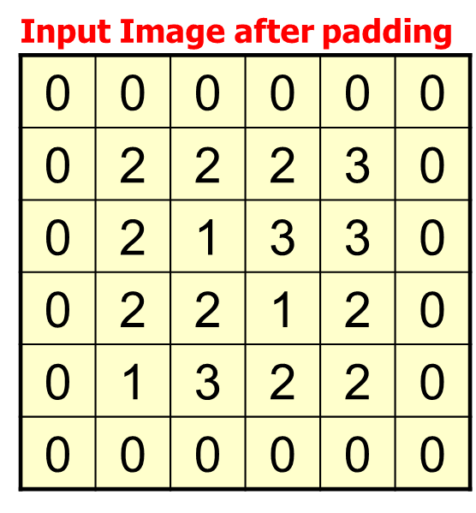
Convolution (Linear Filtering)
1
1
1
1*0+1*0+1*0+
-1*0+2*2+1*2+
-1*0+-1*2+1*1
=5
-1
2
1
-1
-1
1
1
1
1
0
0
-1
2
2
2
3
5
4
2
-1
2
1
3
3
Output Image, g
-2
1
0
2
2
1
2
0
1
3
2
2
Input Image, f

Slide 3
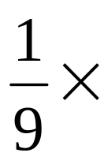
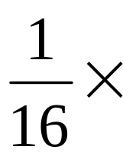
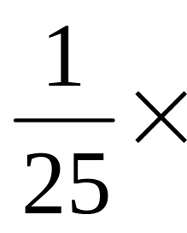
3x3 Smoothing Linear Filters
Smoothing Linear Filters/ Averaging Filters
The idea is replacing the value of every pixel in an image by the average of pixels contained in the neighborhood of the filter mask.
1
1
1
1
1
1
1
1
1
Standard average
(Box Filter)
5x5 Smoothing Linear Filters
1
2
1
2
4
2
1
1
1
1
1
1
1
1
1
1
1
2
1
1
1
1
1
1
1
1
1
1
1
Weighted average
1
1
1
1
1

Slide 4
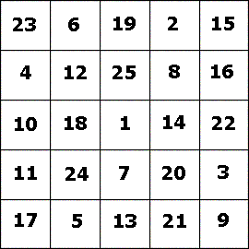
Solution
Perform averaging operation using the 3X3 filter and show the smoothed image matrix. For corner pixels apply Zero padding.
5X5 Input Image
Output Image
5 | 10
1/9 | 1/9 | 1/9
1/9 | 1/9 | 1/9
1/9 | 1/9 | 1/9
3X3 Mask - Filter

Slide 5

Gaussian Filters
Gaussian filters choose the weight of the mask according to the shape of the Gaussian function.
The value of the center pixel is greater and as the distance between the pixel and the center pixel increases, the mask weight decreases.

Slide 6
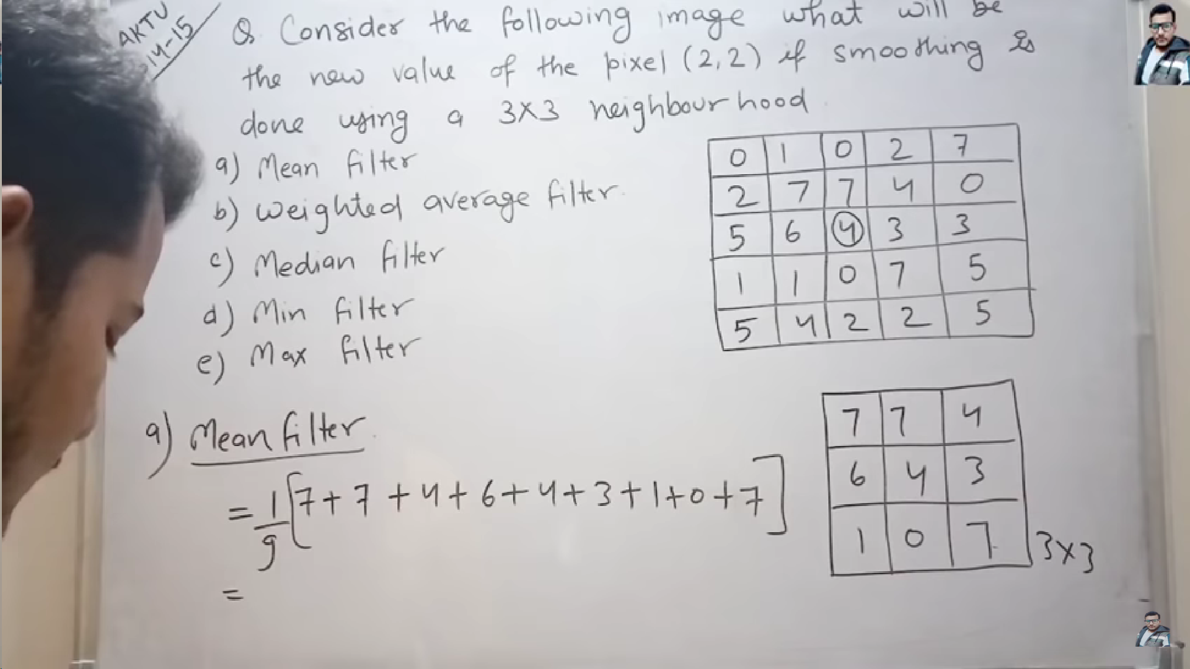

Order-Statistics Filters
Center element = 4
After applying 3x3 neighborhood smoothing around 4

Slide 7
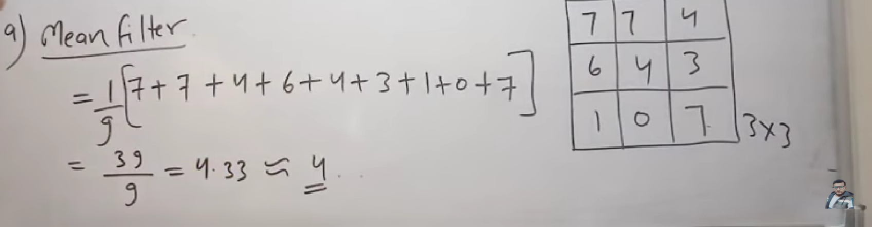

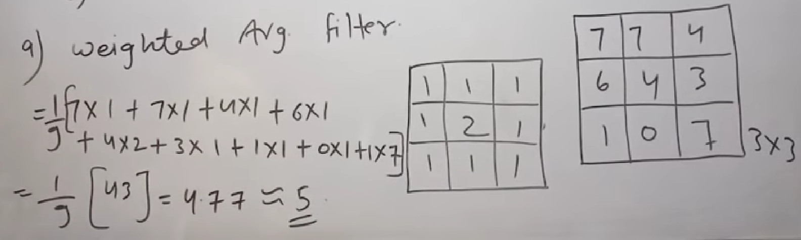
Assuming another matrix (mask) for finding out average

Slide 8
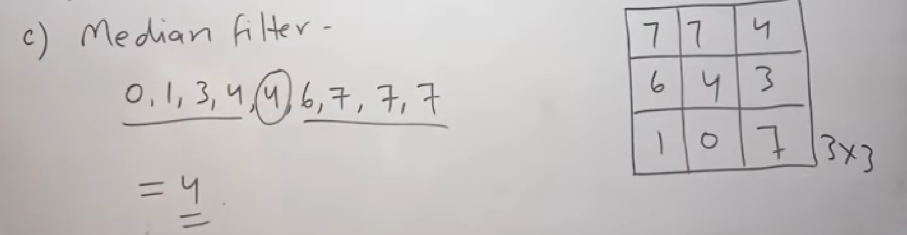
Arrange all elements of matrix in ascending order and find middle element
d) Min filter = 0
e) Max filter = 7

Slide 9
Sharpening filters
It enhances the details of an image.
High frequency components have detailed information in the form of edges and boundaries.
Sharpening algorithms are used to separate object outline - edge enhancement algorithm.

Slide 10
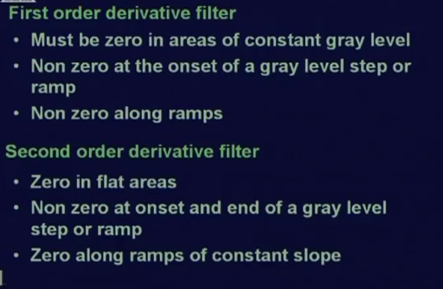
Sharpening filters

Slide 11

Gray-level profile
0
0
0
1
2
3
2
0
0
2
2
6
3
3
2
2
3
3
0
0
0
0
0
0
7
7
6
5
5
3
7
6
5
4
3
2
1
0

Slide 12
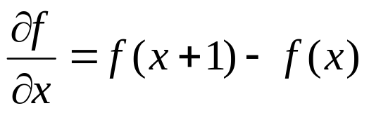






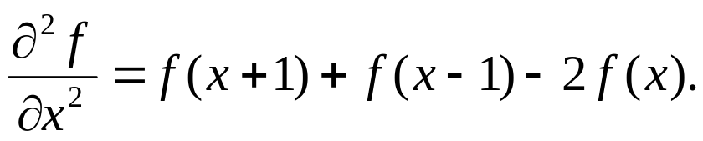
Derivative of image profile
3 – 2 = 1 2 – 3 = -1
0 0 0 1 2 3 2 0 0 2 2 6 3 3 2 2 3 3 0 0 0 0 0 0 7 7 6 5 5 3
first
0 0 1 1 1-1-2 0 2 0 4-3 0-1 0 1 0-3 0 0 0 0 0-7 0-1-1 0-2
second
0-1 0 0-2-1 2 2-2 4-7 3-1 1 1-1-3 3 0 0 0 0-7 7-1 0 1-2
5 + 7 - 2(6) = 0

Slide 13
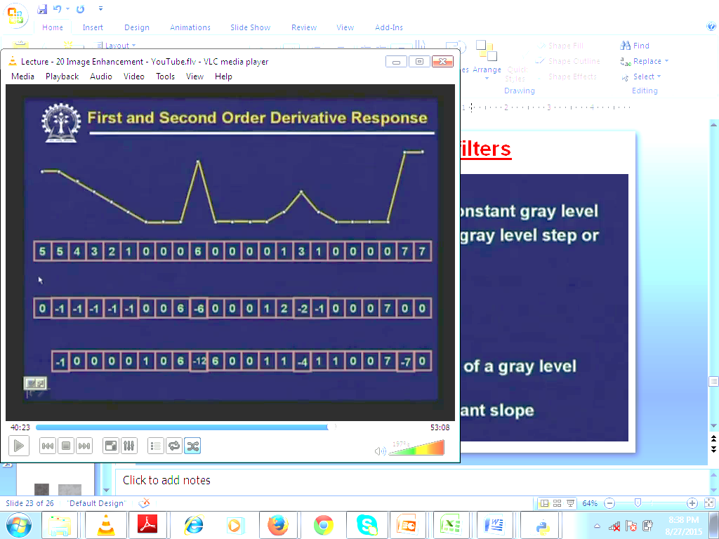
Sharpening filters

Slide 14
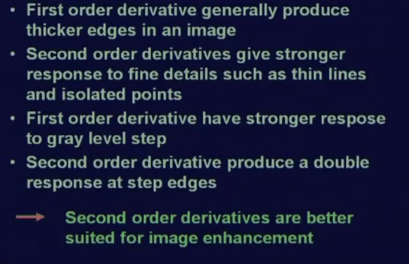
Sharpening filters

Slide 15
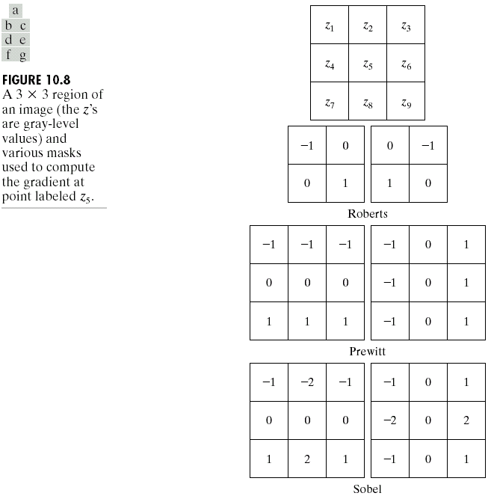
Laplacian Filter
Apply normal convolution with 0 padding. Just keep in mind the general structure of a Laplacian filter.
0
1
0
-1
0
-1
1
1
1
-1
-1
-1
1
-4
1
0
4
0
1
-8
1
-1
8
-1
0
1
0
-1
0
-1
1
1
1
-1
-1
-1

Slide 16
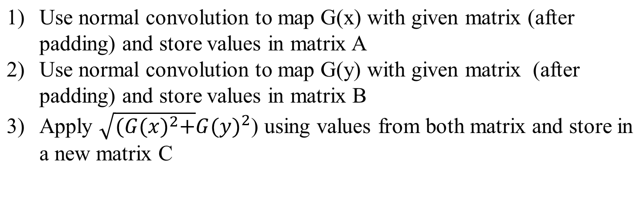


Sobel’s Method
https://youtu.be/EOlUrwDRA2k?si=1N6S-dXLyvT2w-0j
-1
0
1
G(x) mask
G(y) mask
1
2
1
-2
0
2
0
0
0
-1
0
1
-1
-2
-1

